Slide 1

What is DevOps ?

Slide 2
Trends of IT industry
The IT industry has undergone several phases of evolution over the years. In the early days, IT was primarily focused on automating manual processes and improving efficiency. This was achieved through the development of various software and hardware solutions. As technology evolved, IT became more focused on delivering value to businesses and end-users, with a greater emphasis on software development and innovation. This shift was driven by a number of factors, such as the growing importance of technology in everyday life, the increasing complexity of business processes, and the rise of the digital economy. Today, IT plays a critical role in enabling businesses to operate efficiently and effectively, and in driving innovation across a wide range of industries.
Primarily focused on automating manual processes and improving efficiency
Focused on delivering value to businesses and end-user, with a greater emphasis on software development and innovation.
The IT industry today is the move towards cloud computing. Cloud computing enables businesses to access software over the internet instead of relying on on-premises infrastructure.
Cybersecurity is another area of increasing importance in the IT industry. With the rise of cyber threats and data breaches.

Slide 3
Workflow
Step 01
Initial
Formation of teams for development and operations
Step 02
Planning
Planning feature tasks and technical moments
Step 03
Development
Development time
Step 04
Testing
Testing platform in different ways
Step 05
Identifying bugs
Find and specify identified bugs
Step 05
Release
Deadline was always excited in most of the time

Slide 4
Waterfall
Requirement analysis
System Design
Waterfall is a linear, sequential approach that involves completing each phase of a project before moving onto the next one.
Implementation
Testing
Waterfall is often used for projects that have well-defined requirements and a clear end goal. It is a more structured approach that can help ensure that a project stays on track and is completed on time and within budget. However, it can also be inflexible and may not allow for changes or adjustments to be made during the project.
Deployment
Maintenance

Slide 5
Requirements definition
Agile
Analysis of concepts
Agile is an iterative, incremental approach that involves breaking a project down into smaller, more manageable parts and iterating on each part as necessary. is a more flexible approach that is better suited to projects that are less well-defined or where requirements may change over time. It involves working in short iterations, often called sprints, and focusing on delivering working software or other deliverables at the end of each iteration. This allows for greater collaboration and feedback from stakeholders, which can help ensure that the final product meets their needs and expectations.
Review and monitor
Cycle
Planning of sprints
Create and impliment
Collaborative design and development

Slide 6
What is DevOps ?
DevOps is about to deliver more quickly, reliably, and efficiently
By implementing automation mechanisms that reduce time-to-market, improve customer satisfaction, and manage risk more effectively.
Why DevOps ?
Set of practices that emphasizes collaboration and communication between development and operations teams.
DevOps is a team undertaking.
Is important because it helps to streamline the software development process and improve collaboration between development and operations teams. By breaking down the traditional silos between these teams and promoting cross-functional collaboration
DevOps implement monitoring systems
Using a combination of log management, metrics collection, and alerting.
DevOps are taking testing to a new level
Automating tests can help achieve a 90% success rate, reducing the need for manual testing and allowing for rapid turnaround times.

Slide 7
DevOps Roles
Overall, DevOps is a complex and multifaceted field that requires a wide range of skills and competencies. By possessing these skills and competencies and staying committed to continuous learning, DevOps professionals can help their organizations deliver high-quality software products at a faster rate, while fostering collaboration and teamwork between development and operations teams. Each role has specific responsibilities related to designing and implementing various aspects of DevOps practices and tools.
Product Owner
Quality Assurance Engineer
Information Security Engineer
DevOps Project Manager
The intersection between the DevOps team and customer.
Review test design and process feedback.
Ensure adequate system and data security.
Verifies compliance with customer expectations.
DevOps Developer
Operations Engineer
Release Manager
Transforms the customer's business goals into solution.
Monitors and maintains the product environment and infrastructure.
Manages and coordinates the deployment and release processes.

Slide 8
Infrastructure as Code
Provisioning
Configuration Management
Source Code
Version Control
Code
Deploy
Plan
Build
Automation
Build
Dev
Release
Ops
Operate
Container Management
Orchestration
Plan
Test
Monitor
Continuous Integration/ Continuous Delivery or Deployment (CI/CD)
Visualisations
Logging
Quality Control

Slide 9



Source Code Version Control
Main
V0.1
V0.2
V1.0
GitFlow
Hotfix
Development
Feature

Slide 10


Build Automation
Pom file
Checks the dependencies
Maven
Build plugins
Make commands are executed in pom file
Build profile

Slide 11
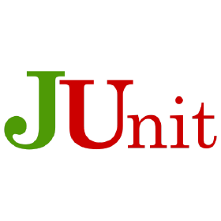




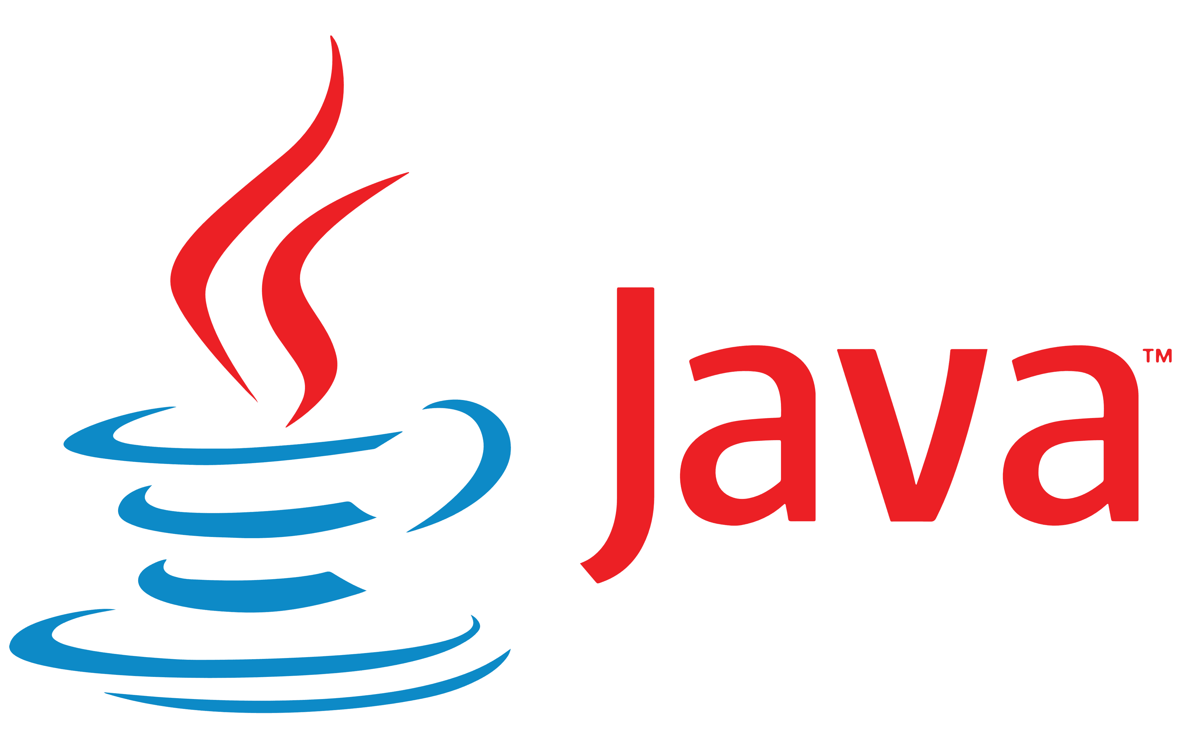
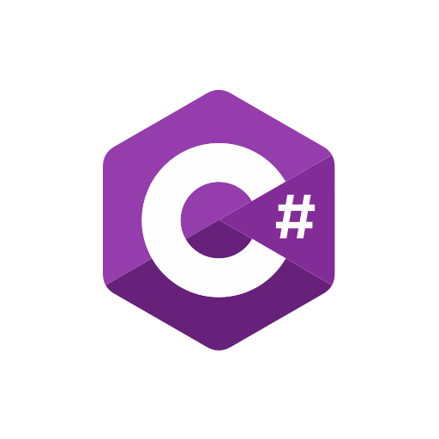

Quality Control
Selenium web drivers
Web Browsers
HTTP Request
HTTP Request
Selenium client library

Slide 12



Continuous Integration/ Continuous Deployment
Job1
Gitlab Runners
Agent that run CI/CD jobs
Job2
Gitlab Server
Gitlab Server assigns pipeline jobs to available Runners
Nginx
Gitlab Pages
Gitlab Workhorse
Gitlab Shell
Gitaly
Puma
PostgreSQL
Redis
Sidekiq

Slide 13


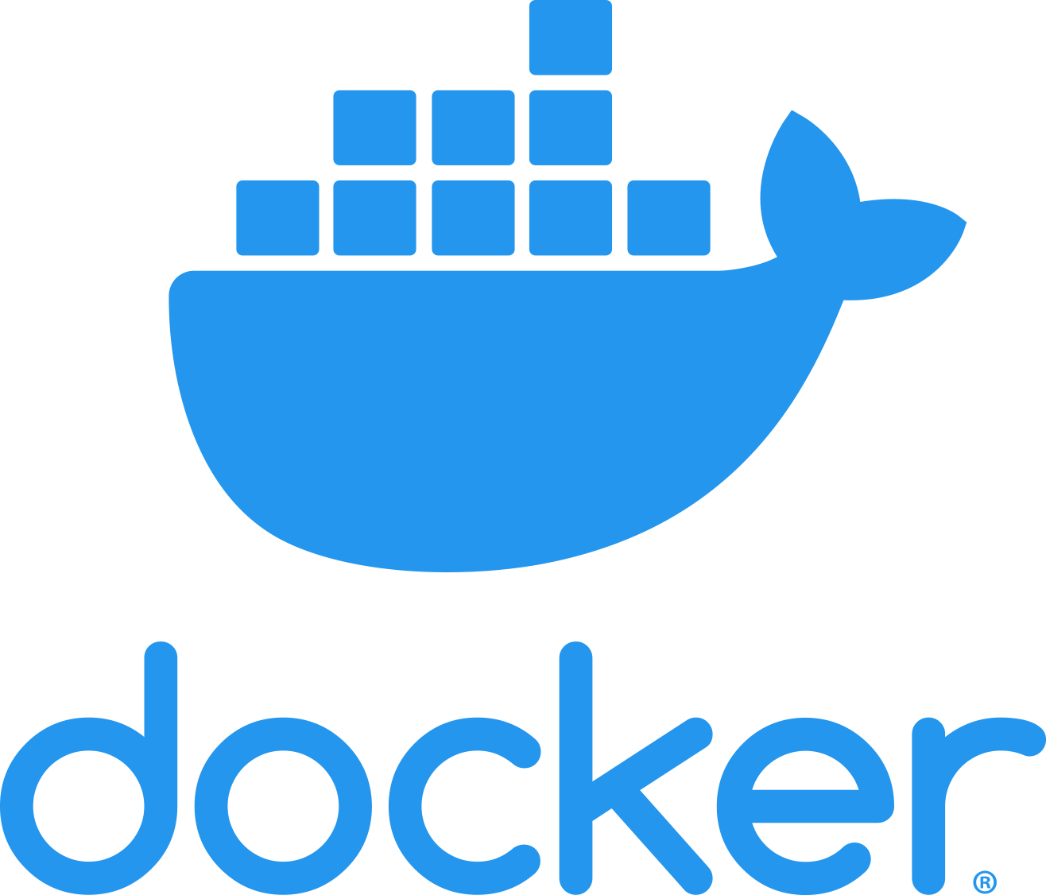



Infrastructure as Code & Provisioning
Docker Host
DockerClient
Docker Registry
docker build
Docker daemon
docker pull
Containers
Images
docker run

Slide 14


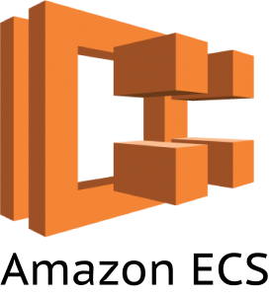
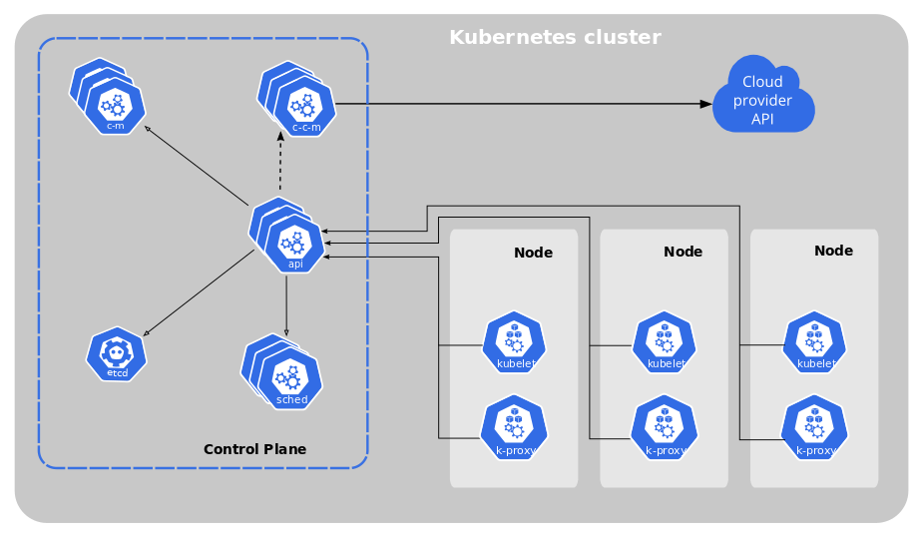
Container management / Orchestration

Slide 15



Monitoring
Zabbix Server
User
Internet
Zabbix Web
Remote Servers
Database
Zabbix Instance

Slide 16




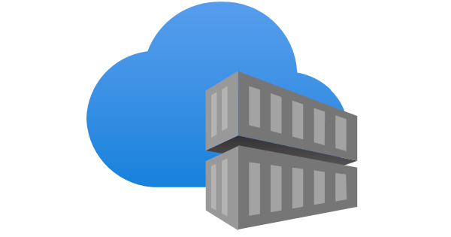
CI/CD Pipeline
Commit
Developers
Code/DockerFile/HelmCharts
Gitlab-CI
Testing
Docker Build
Docker Push
Deploy
Cloud provider
Container registry

Slide 17
Better resource & Higher quality
Automation
Greater scalability
DevOps purpose
Reliability
DevOps is a game-changing methodology that has transformed the way software is developed, delivered, and maintained. It provides organizations with a competitive advantage by enabling them to deliver high-quality software at a faster rate while fostering collaboration and teamwork between development and operations teams.
DevOps Development Benefits
Better user experience
Reduced time to recover
Faster product delivery & updates
Efficiency & cost saving
Shorter dev cycle

Slide 18

Questions & Answers
Notes:
Va multumesc, ca ma-ati ascultat, si ati facut impreuna cu mine, primii pasi de a vedea lumea cu ochii unui Devops Engineer. In caz ca aveti careva intrebari suplimentare, ma puteti contacta pe linkedin, la care eu voi raspunde cu cea mai mare placere.

